Slide 1



Jul, 8th | PARIS
The Dark Side of Social Media
Ferdinand Leube
DAFT May 22

Slide 2


Business case
Domain
Impacts of social media on society and on gun violence in the US
Main Hypothesis
Through an early confrontation with violence and weapons on social media, children in current generation are getting used to this kind of content and are therefor less inhibited to use violent methods when facing a problem, dispute, struggling with mental illness etc.
To do
What factors might have an impact on/correlation with increase of gun violence?
Is Hypothesis supported by data analysis results?
Consequence of observations: create deep learning model able to identify image contents containing weapons

Slide 3
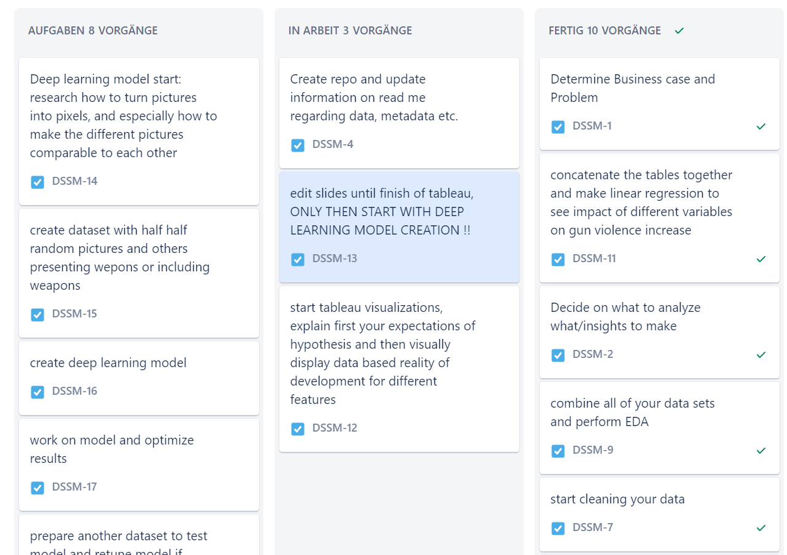
Plan
Data collection
Data cleaning
EDA
Preparing data for regression model
Running regression model
Analyze results
Build deep learning model
Presentation
Summary
Notes:
Step 4: to see feature importance/variable importance on gun violence development

Slide 4
About Data
Average monthly social media users
Open source data having API access to social media platfroms
Year
Gun violence in America
Source: gun violence archive
Location
Information on registered guns
Source: ATF → Bureau of Alcohol, Tobacco, Firearms and Explosives
Year
Number of killed
Number of wounded
Etc.
Different types of registration forms
Focus on: number of imported and manufactored guns ATF_FORM_2
Date/Time
Total licenses
inspections
Percent inspected
Etc.
Notes:
Step 4: to see feature importance/variable importance on gun violence development

Slide 5
About Data
Federal Firearms Licensees and Compliance Inspections
Source ATF → Bureau of Alcohol, Tobacco, Firearms and Explosives
Entity: social media platform
Mental Health
Source: Our world in Data
Entity: country
Year
Monthly users: monthly average visits of specific entity
Country code
Year
Multiple mentall Illnesses/disorders, and perentage of patients by total populaion
Notes:
Step 4: to see feature importance/variable importance on gun violence development

Slide 6
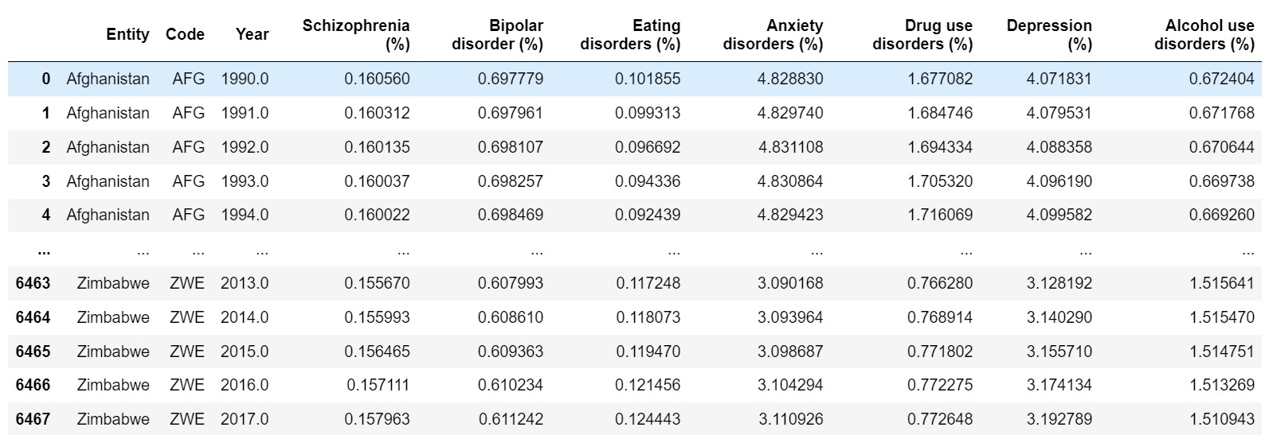
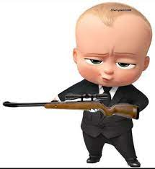
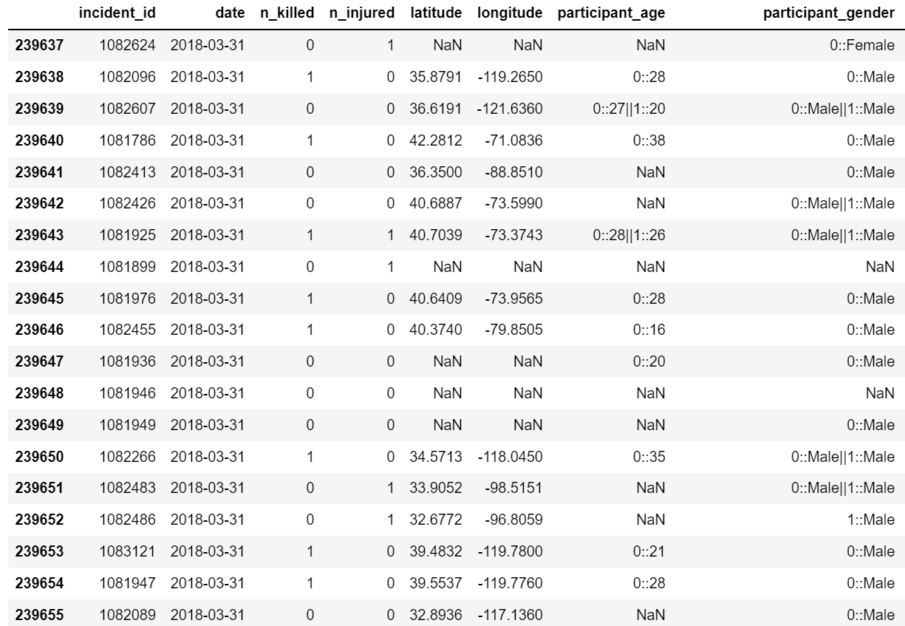
Raw Data Overview
Notes:
Step 4: to see feature importance/variable importance on gun violence development

Slide 7
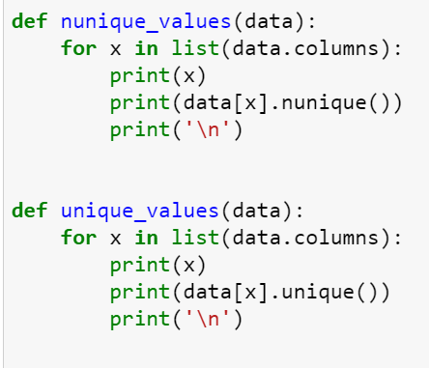
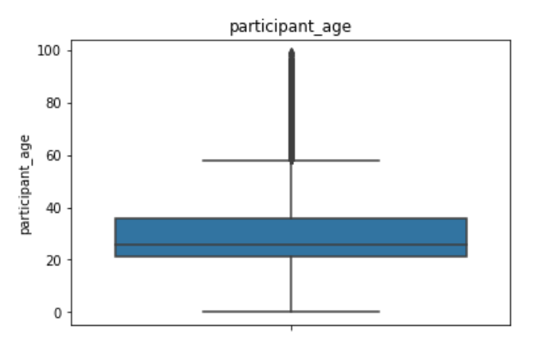
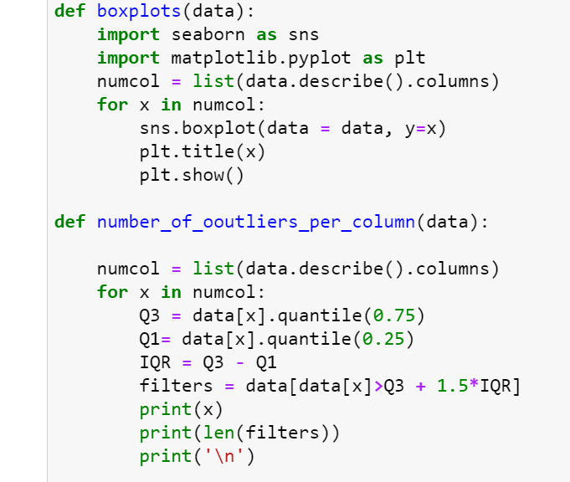
Data cleaning, data prep, EDA
Each step for every dataset:
Check general structure of the data
Select necessary columns
Collect values for US only
Group by year
Check for missing values and deal with them if existent
Notes:
Add pictures of cleaning methods, cleaning functions, time series models

Slide 8
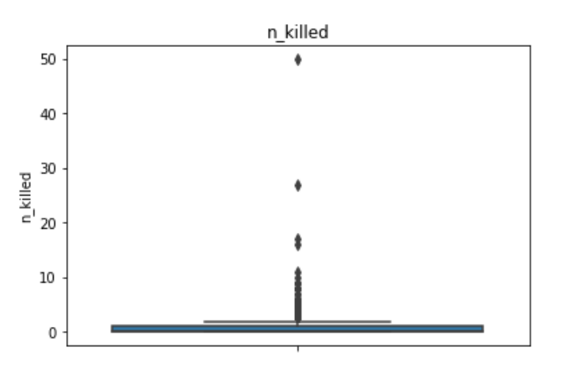
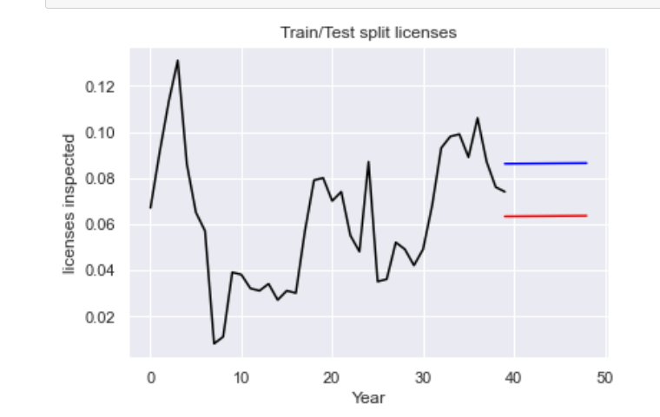
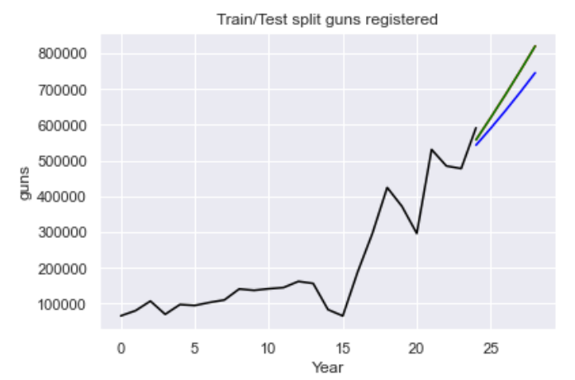
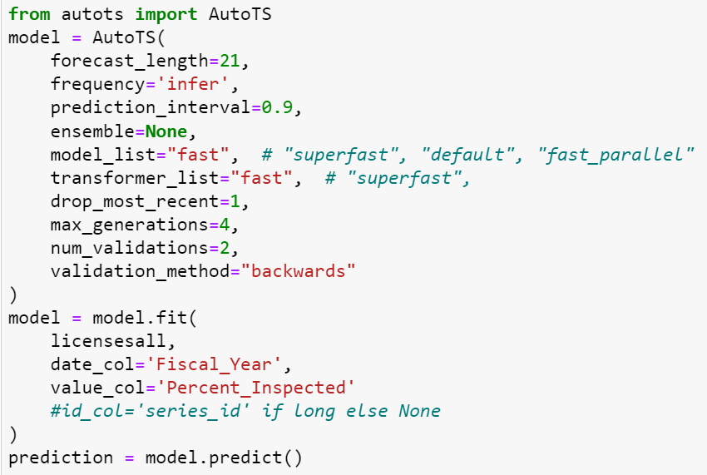
Data cleaning, data prep, EDA
Check for outliers, decide how to handle them
Collect data for comparable years
Use time series and linear regression to make forecast for values of missing years
Notes:
EDA examples, maybe make a few more (

Slide 9
Tableau Visualizations of Developments

Slide 10
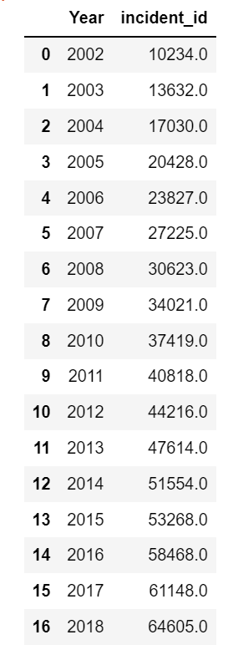
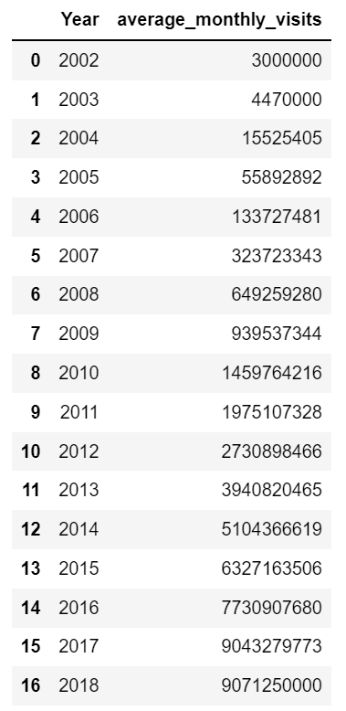
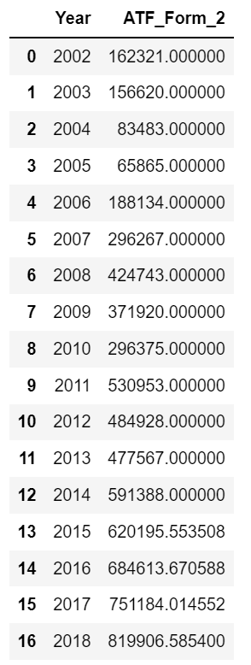
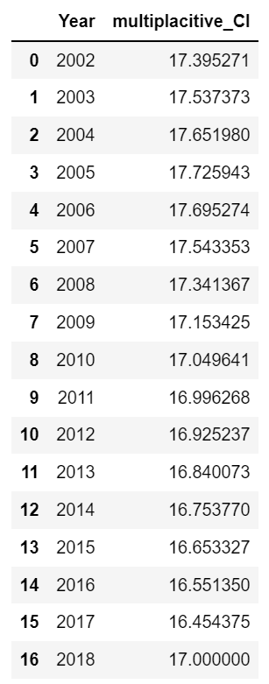
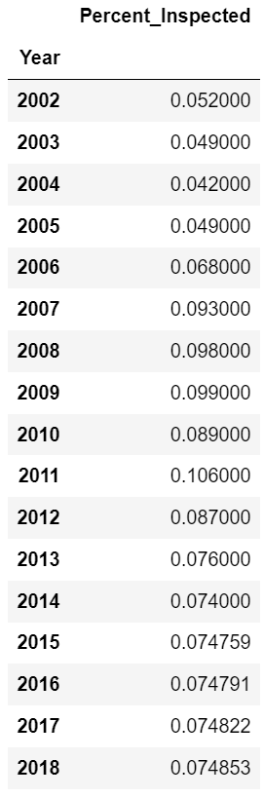
Data Cleaning Results

Slide 11
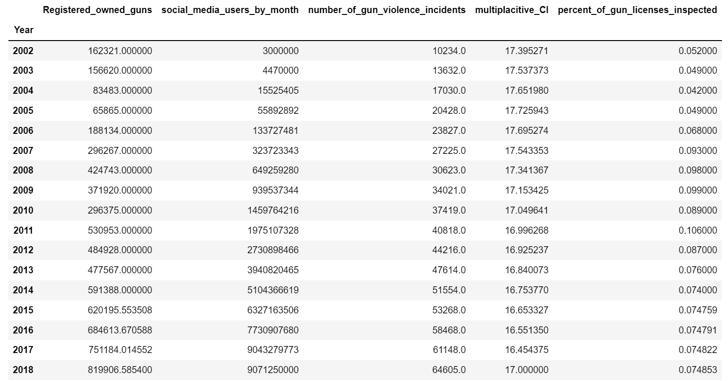
Linear regression model - Preparation
Set year column to index for all
Renamed columns
concatenated

Slide 12
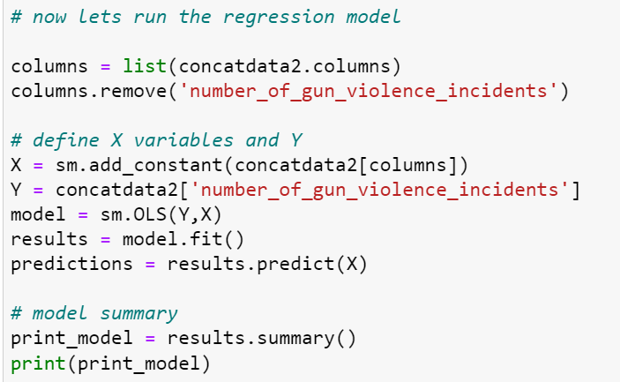
Linear regression model - Preparation

Slide 13
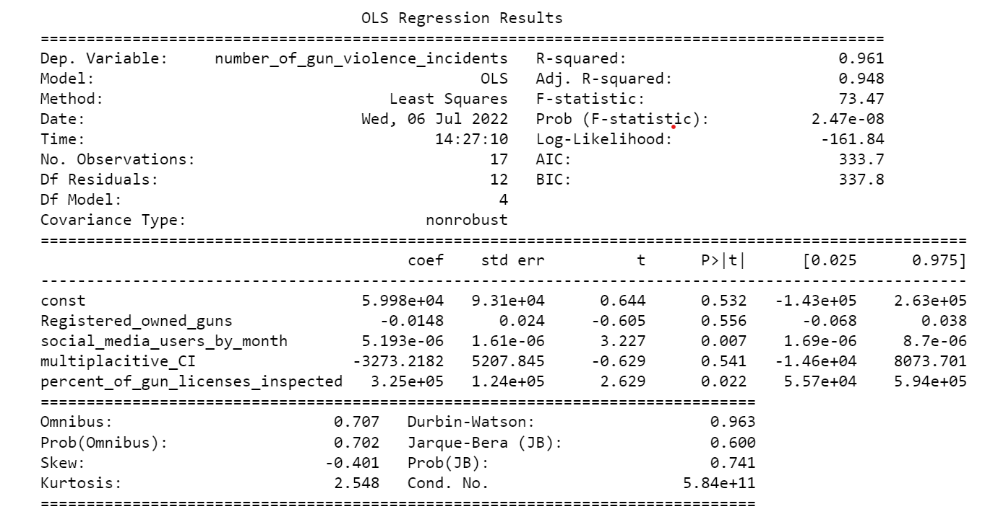
Regression model result
Notes:
high r squarred value --> good fit of the model describing almost all of the variance of the original data
model is statistically significant, high f or also called ANOVA statistic
different features have different significances on outcome of y variable
the lower the P|t| here the better because this is the result of hypothesis test, checking the variables significance, H0 in this case here is that the variable is unsignificant, the lower the value the better because with a significance of 5 maybe 10 percent, you will reject H0 for values below that level and accept H1 being that the tested varibale is significant for the outcome of the y variable
##########################################################
due to the statistical significance of social media users varibale for the gun violence development, we can assume that there might indeed be a correlation between the similar development of these to over the last couple of years
of course that is not the only feature having an impact on such a complex matter, there is a huge range of reasons for this develoment, but nonetheless it is a very interesting relationship that would be worth going into further detailed analysis
other variables having a significant impact:
inspected gun licenses:
research: gun laws have become a little stricter in the US over the last couple of years, also due to increasing gun violence concerns , therefor the statistical signifance can be explained because the trned is the same as the one of gun violence, both increasing over time, looking at the coefficient I would have expected a different outcome: a negative coefficient, you would expect that increased gun license checks and other gun laws enforcement being enforced simoutaniesly would reduce the gun violence, apparently this is not the case
a result that surprised me: mental health feature, no significance for the model, makes sense after previously analyzing the mental illness rate devlopment, 8n recent years only have mental illnesses have been recognized as such, further more mental illnesses did increase at a big rate afer the introduction of social media, but because such illnesses are being taken care of more serously and there are efforts made detecting these earlier, there has been a slow increase in mentall illness rate
also gun ownership unsignificant

Slide 14
Model creation - Preparation
Experiment with libaries such as pillo and matplotlib image libary etc.
Picture collection
Cleaning pictures, arranging picture matrix
Building model
Trying hyperparamter tuning
Restructuring picture data by experimenting with the arrangement of pixels
Rerunning models
Comparing results
Applying external datasets and predicting

Slide 15
Main results

Slide 16
Main results

Slide 17
Main results

Slide 18
The Dark Side of Social Media
Ferdinand Leube
Questions?

